Slide 1

MaccAstro Imaging Trophies
2024 Competitions – 17 Submissions (anonymous)

Slide 2
Ian Morison Imaging Trophy (deep Sky) Section
10 Entries

Slide 3
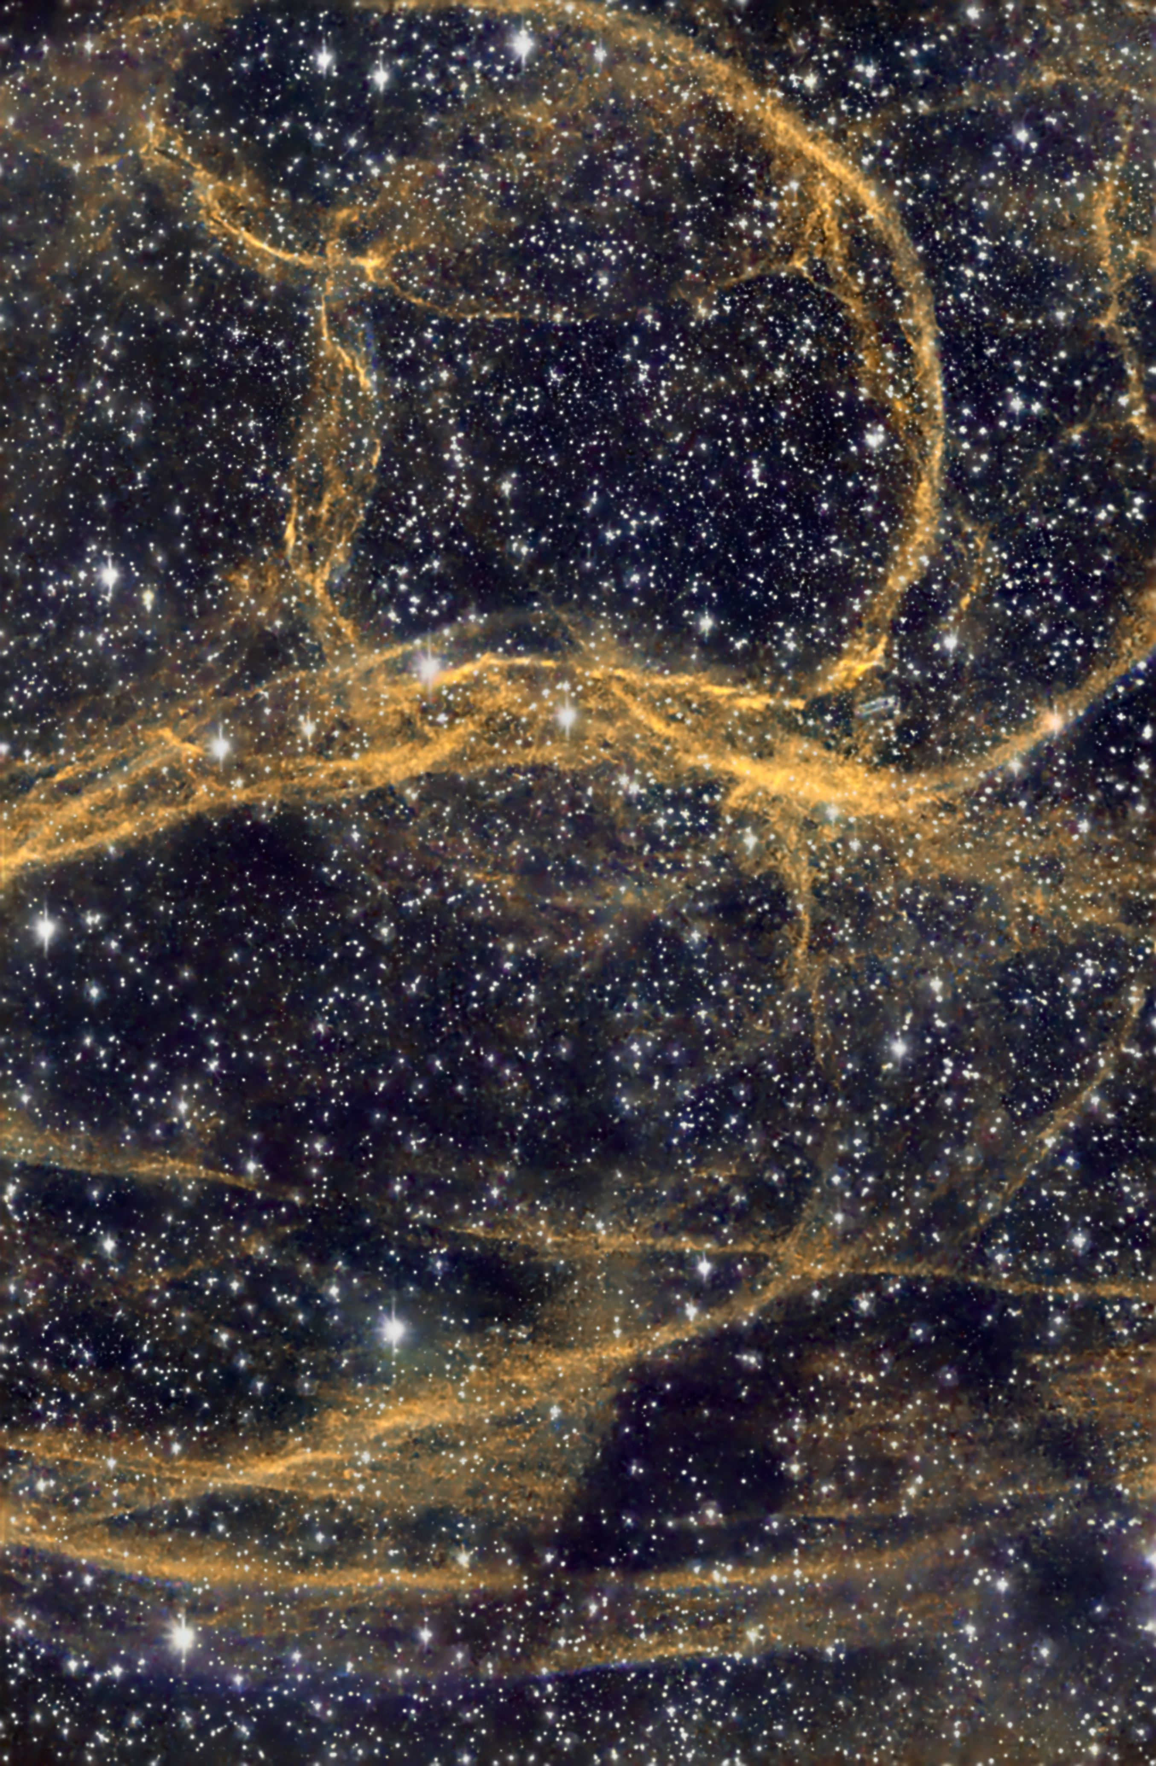
D1
Gold Threads In Space And Time

Slide 4
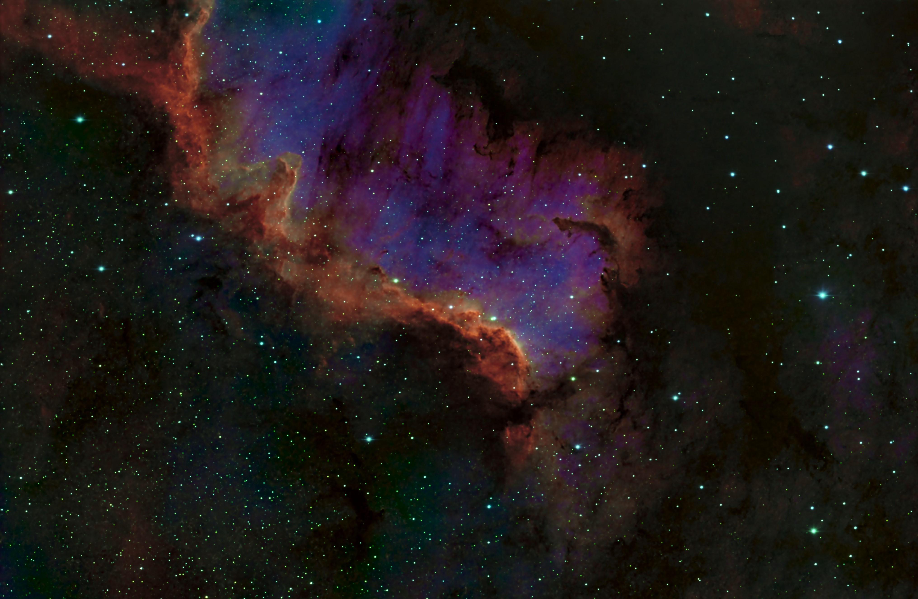
D2
Mexican Wall

Slide 5
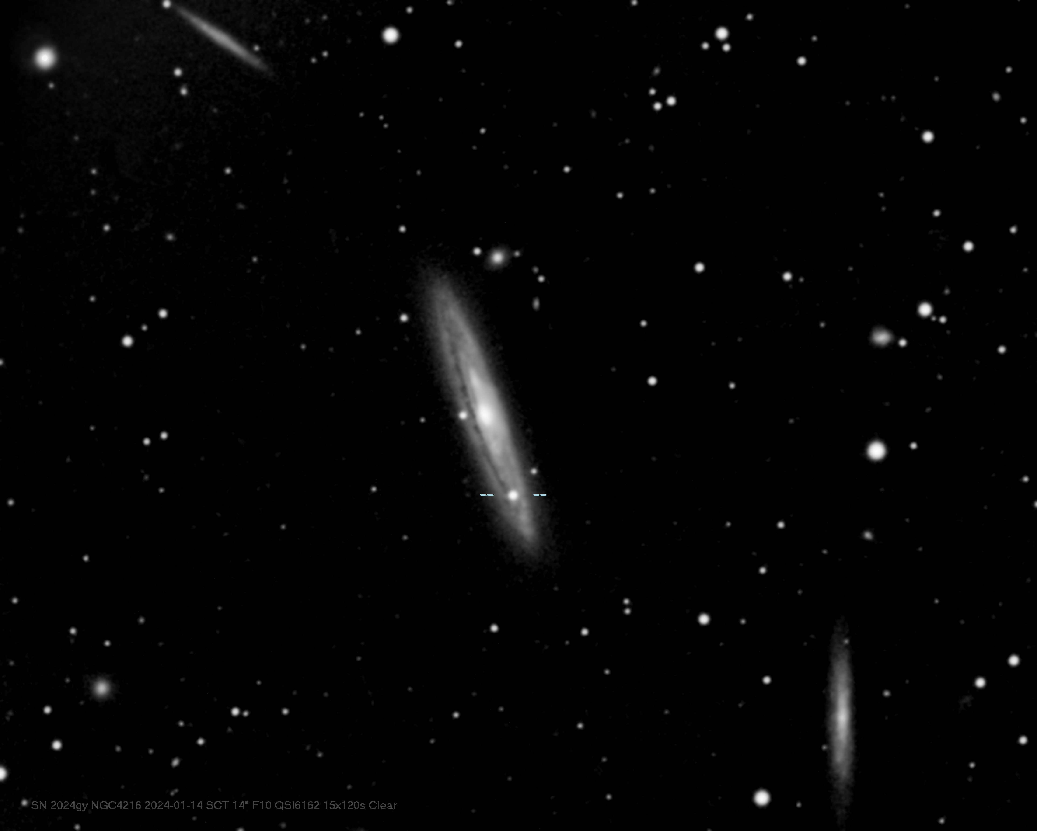
D3
Triple edge on galaxies with supernova

Slide 6
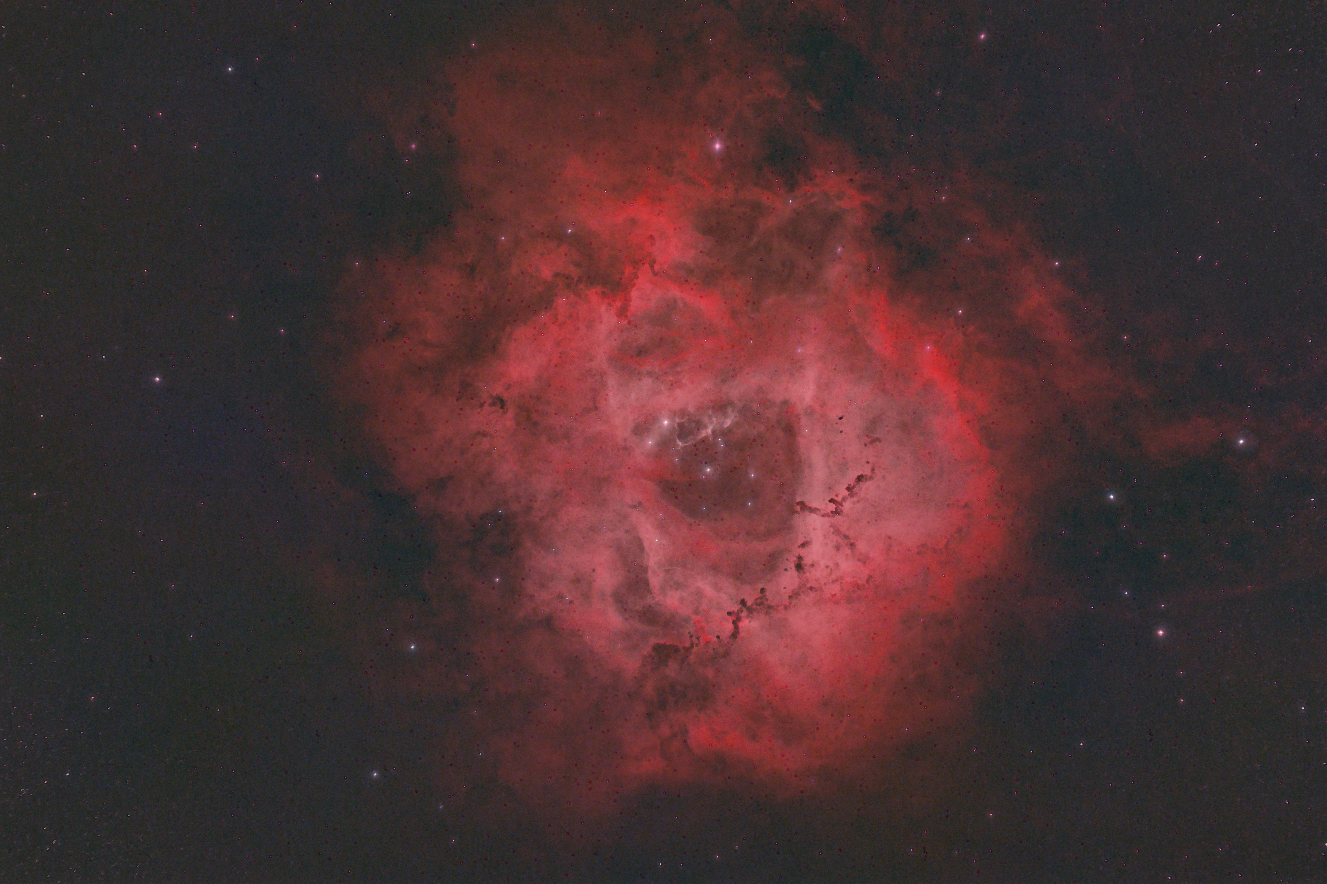
D4
Rosette Nebula

Slide 7
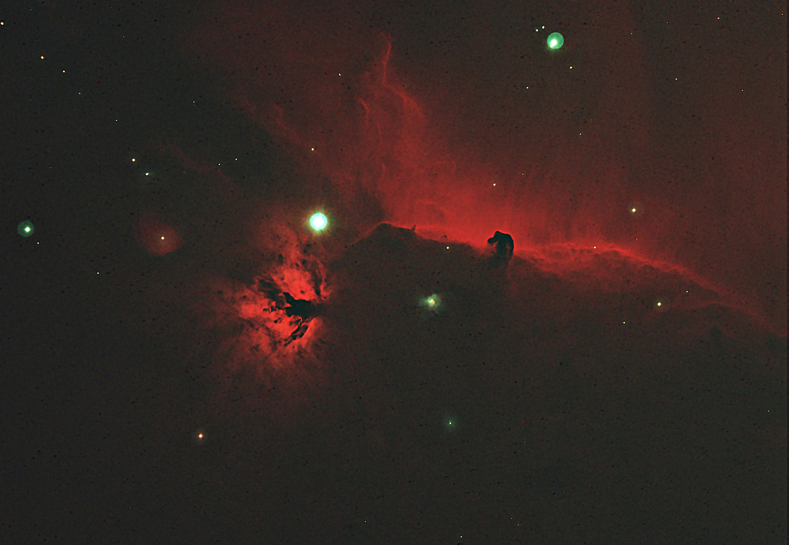
D5
Flame and Horsehead nebulas

Slide 8
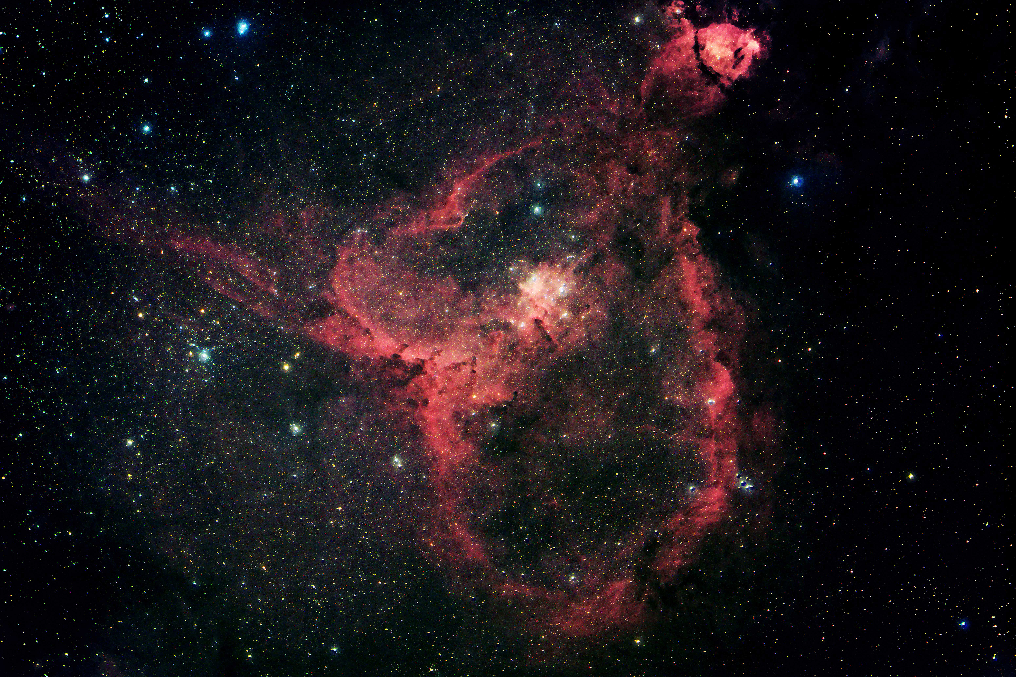
D6
IC1805 Heart Nebula in RGB, Ha

Slide 9
D7
Elephants Trunk Nebula in Ha

Slide 10
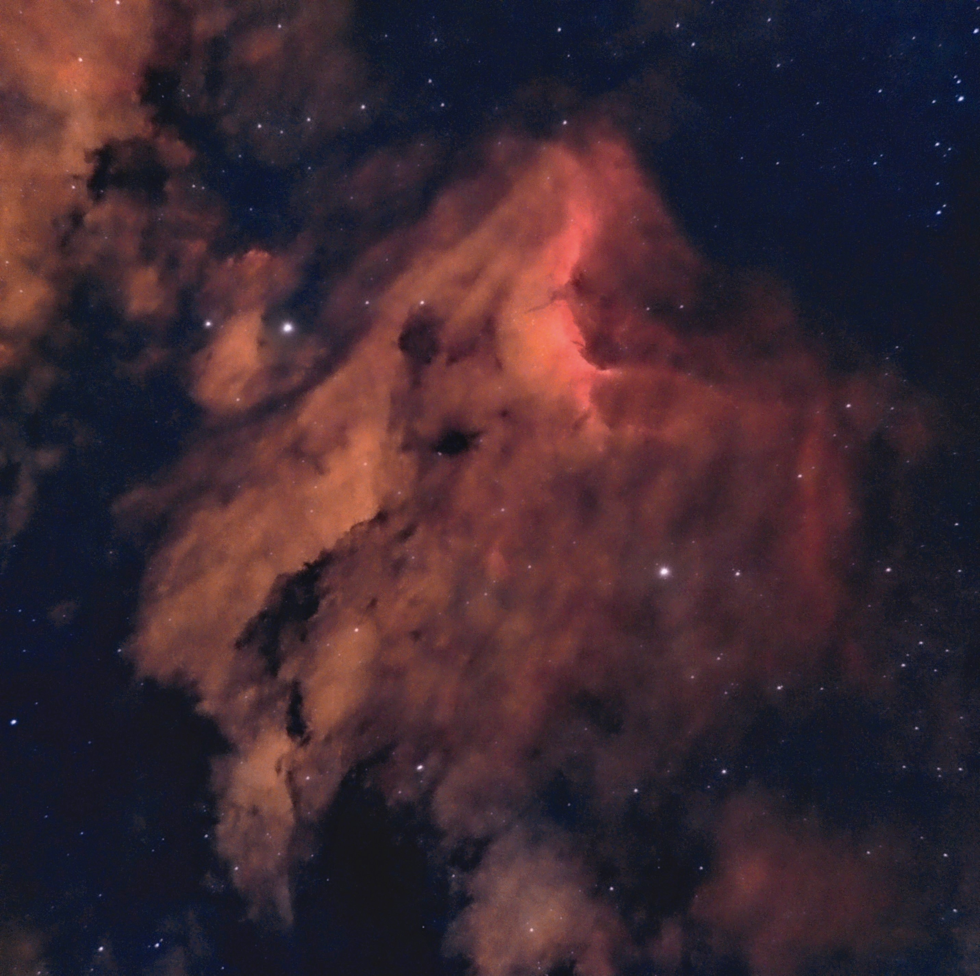
D8

Slide 11
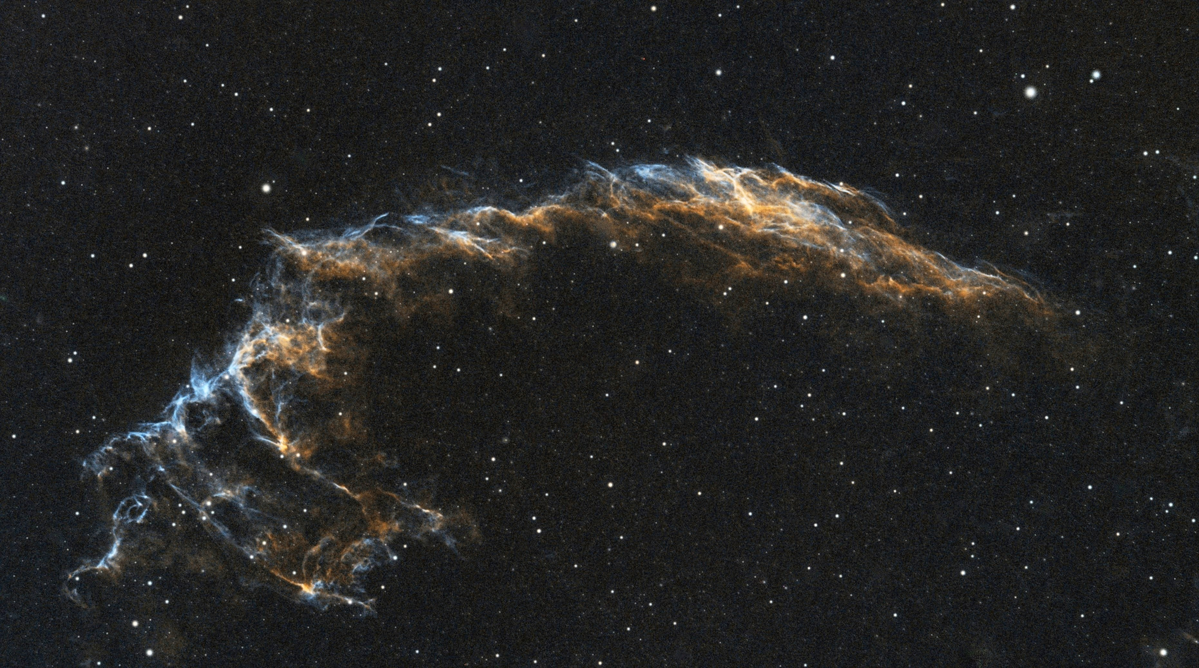
D9

Slide 12
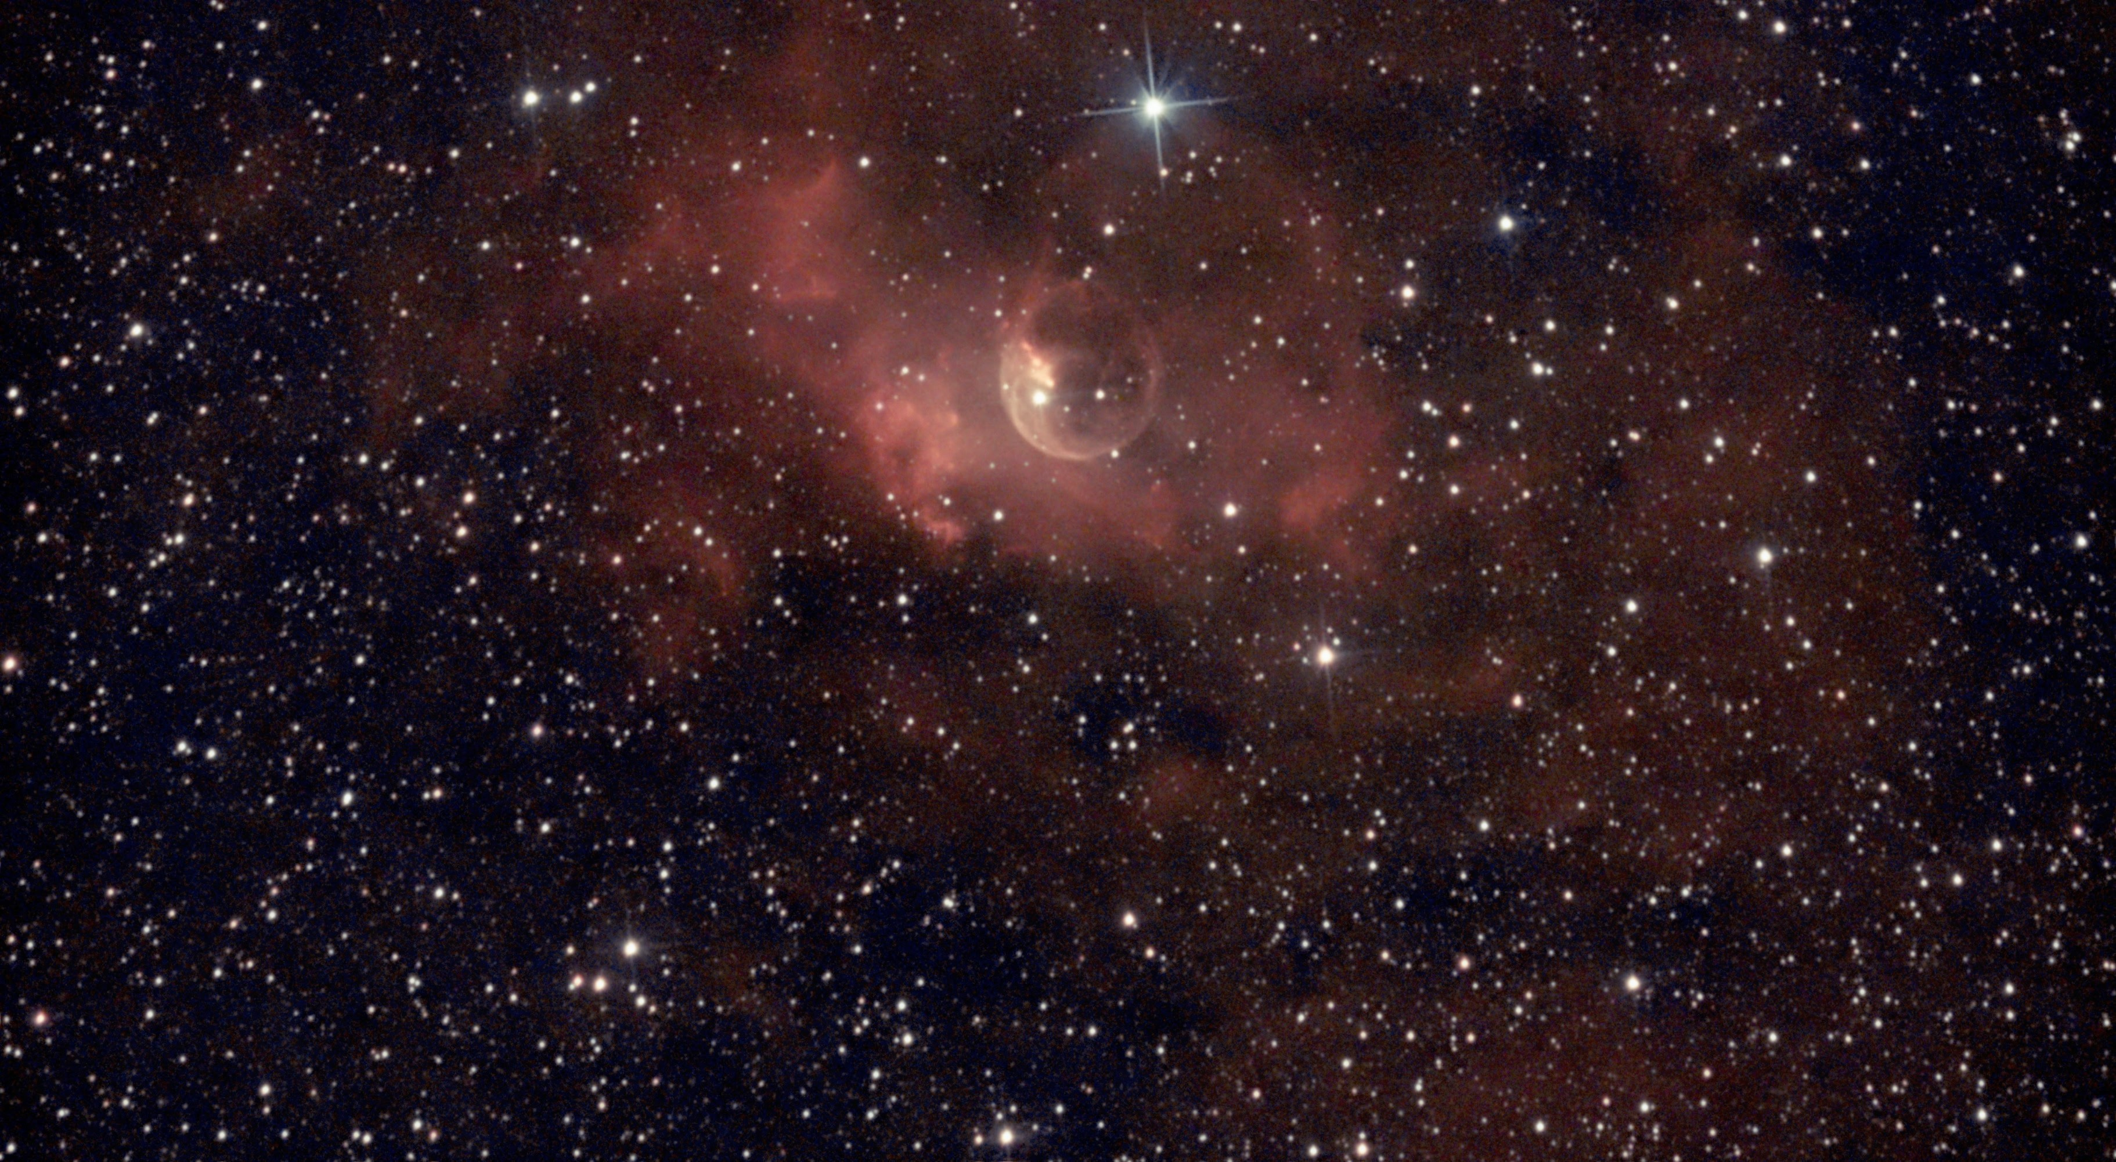
D10

Slide 13
Willcox Wide-sky Trophy Section
7 Entries

Slide 14
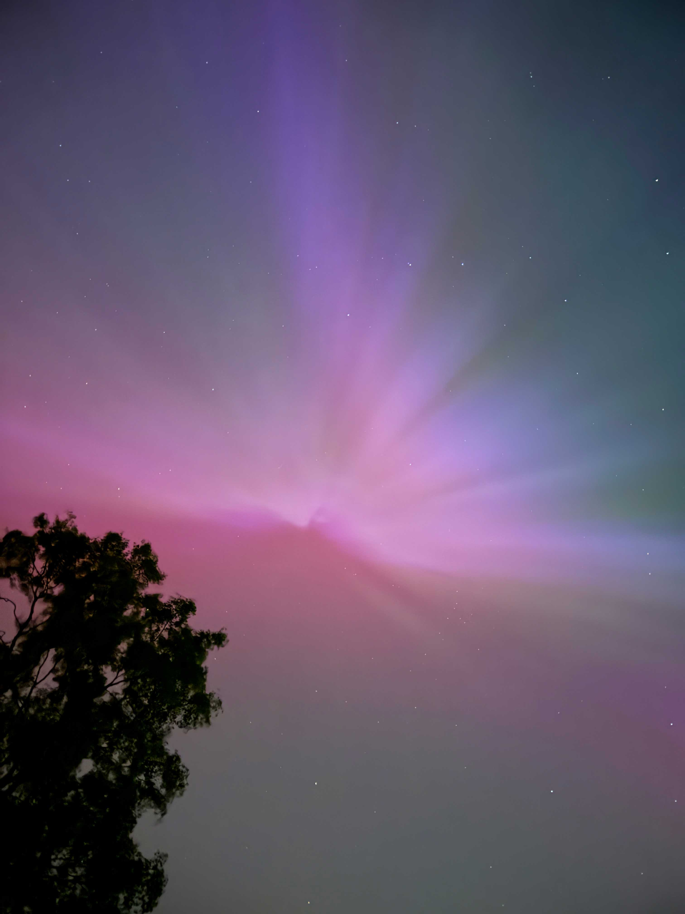
W1
aurora &amp; Plough

Slide 15
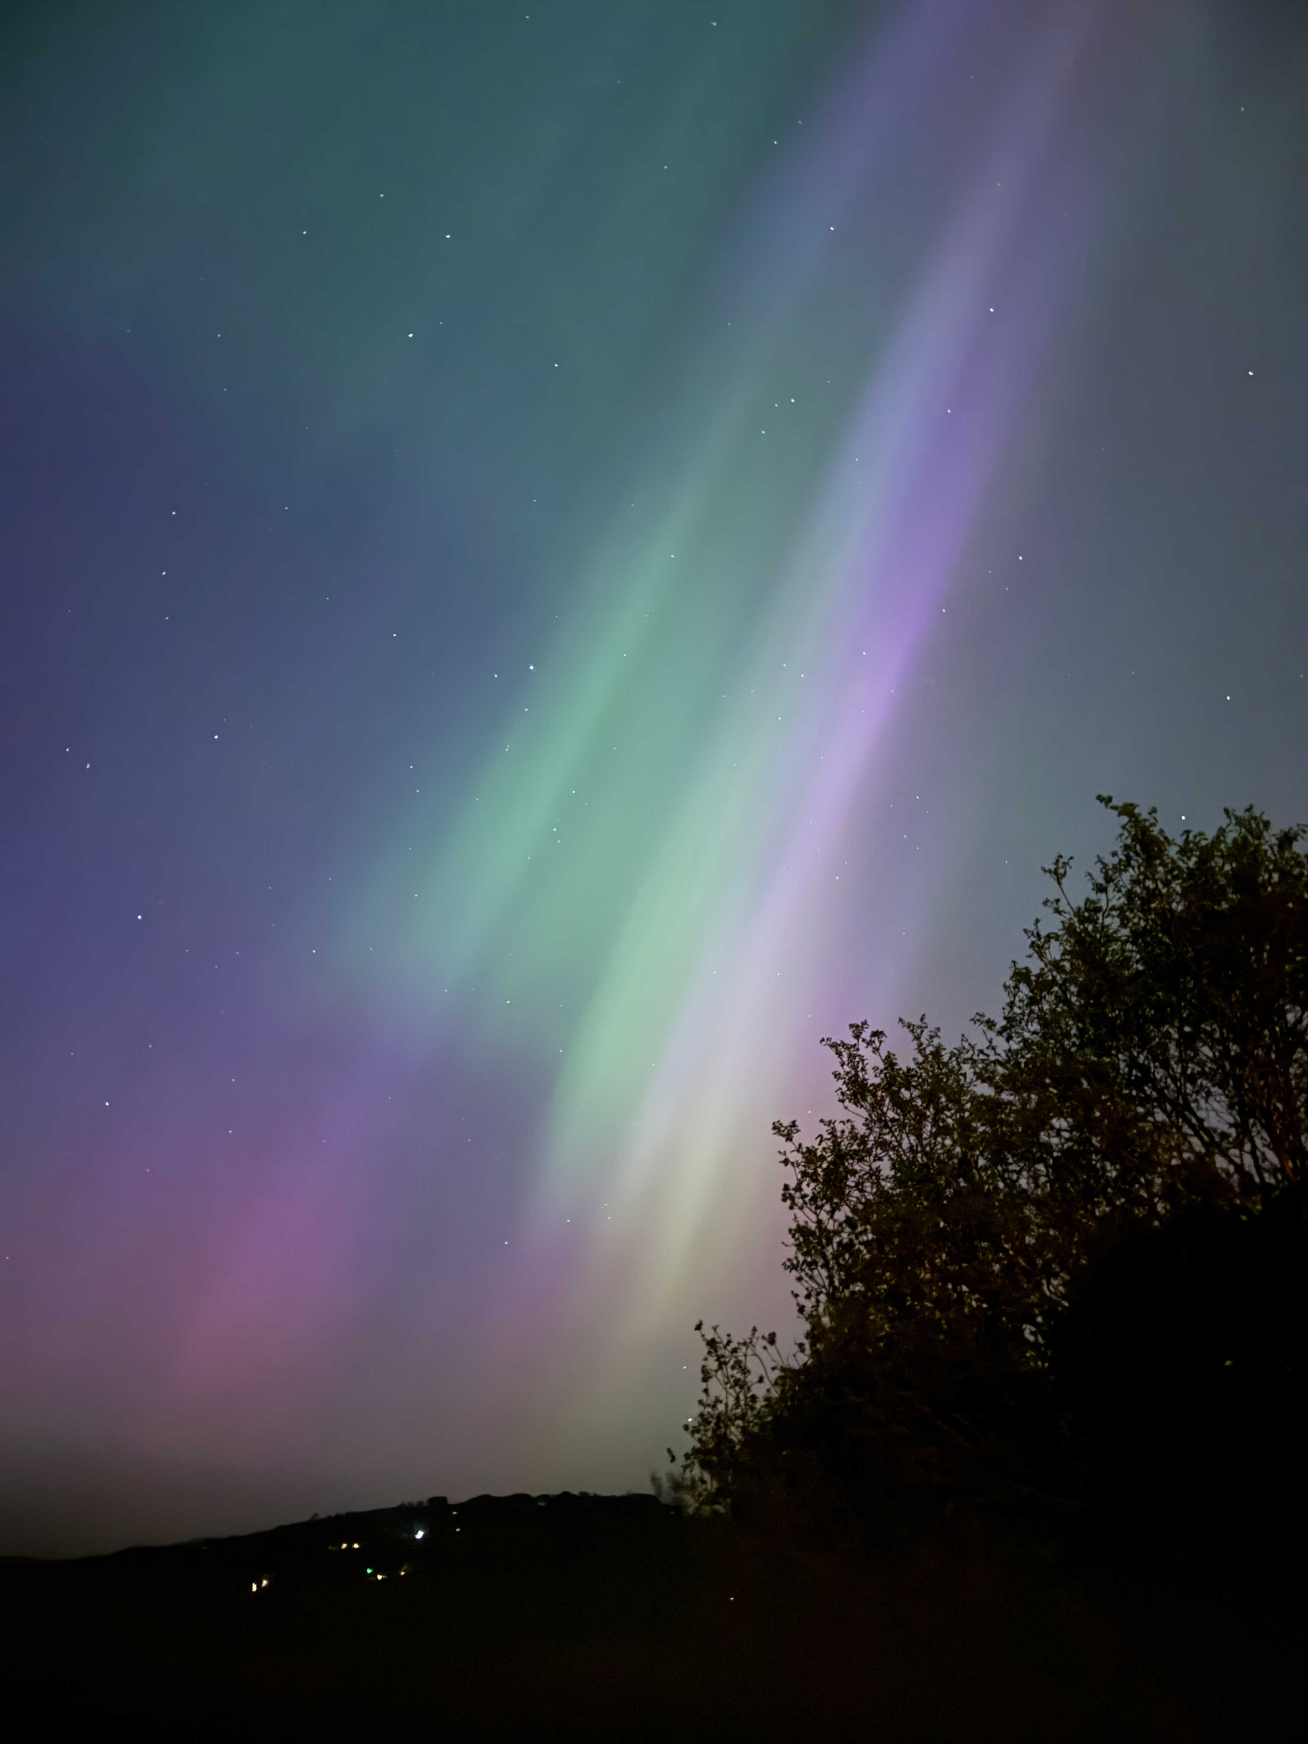
W2
Aurora 2

Slide 16
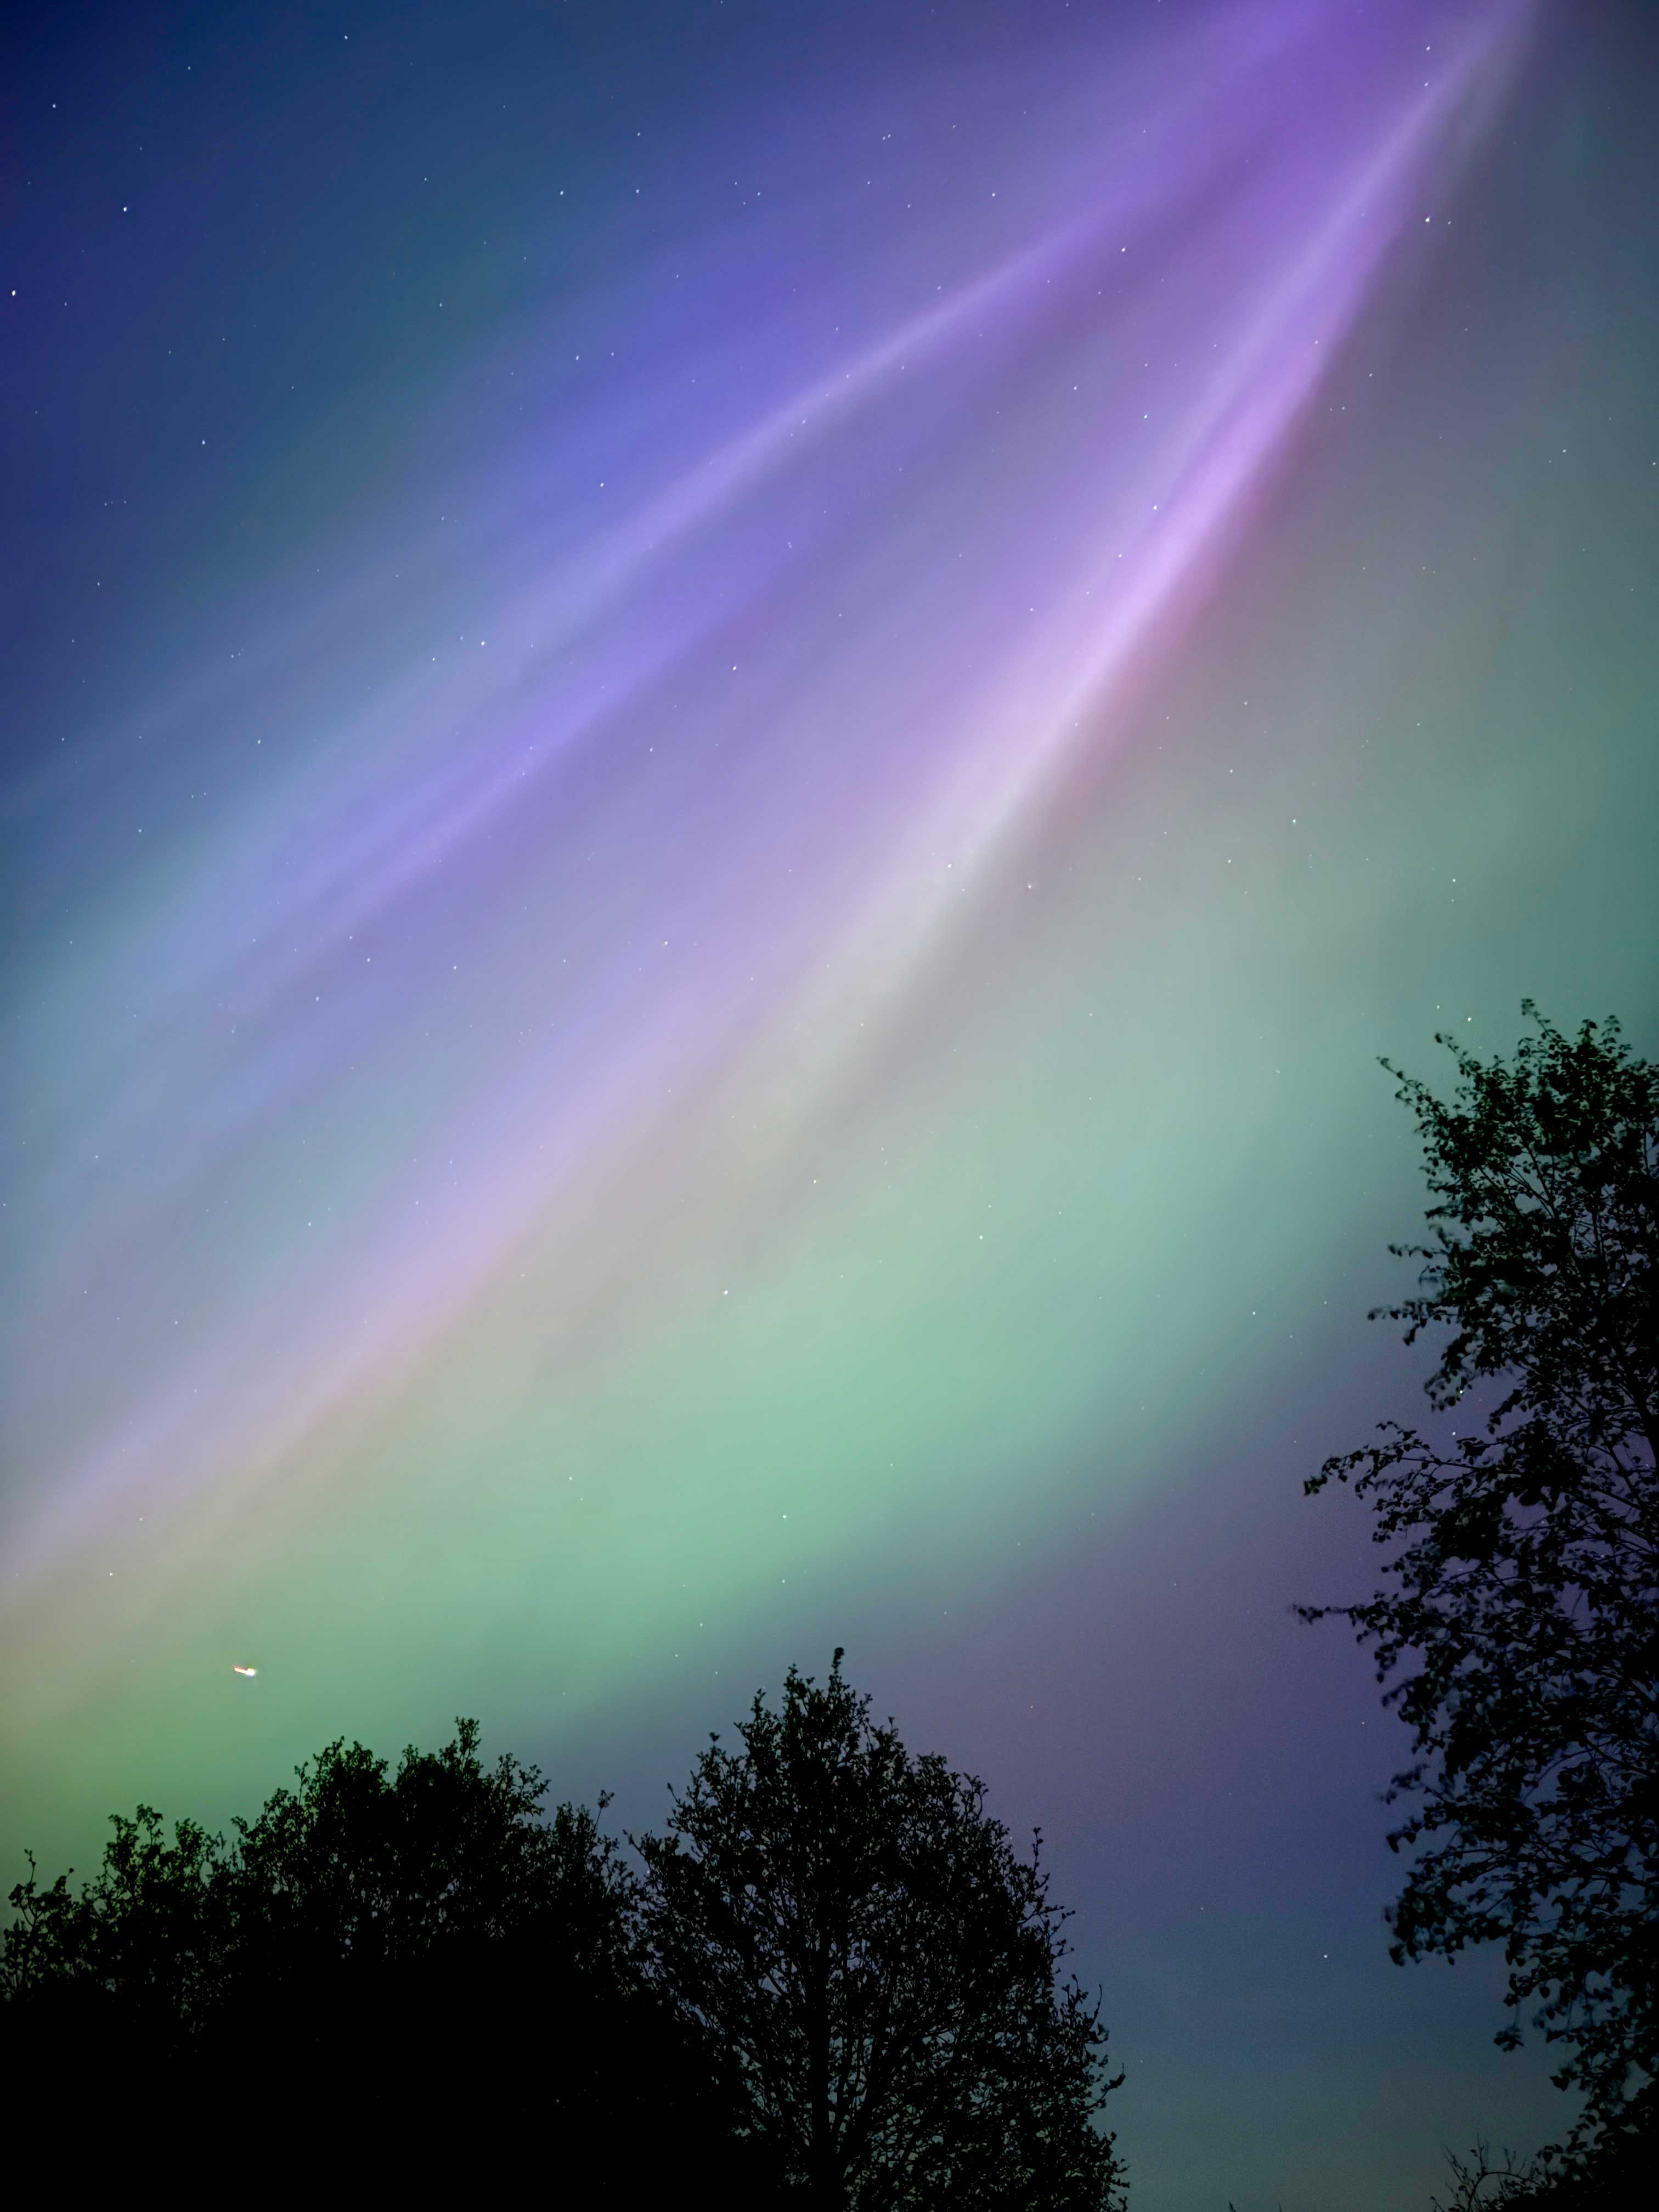
W3
Aurora 3

Slide 17
W4

Slide 18
W5
''

Slide 19
W6
''

Slide 20
W7
''

