Slide 1

MaccAstro Imaging Trophies
2024 Competitions – 17 Submissions (named)

Slide 2
Willcox Wide-sky Trophy Section
4 Entries

Slide 3
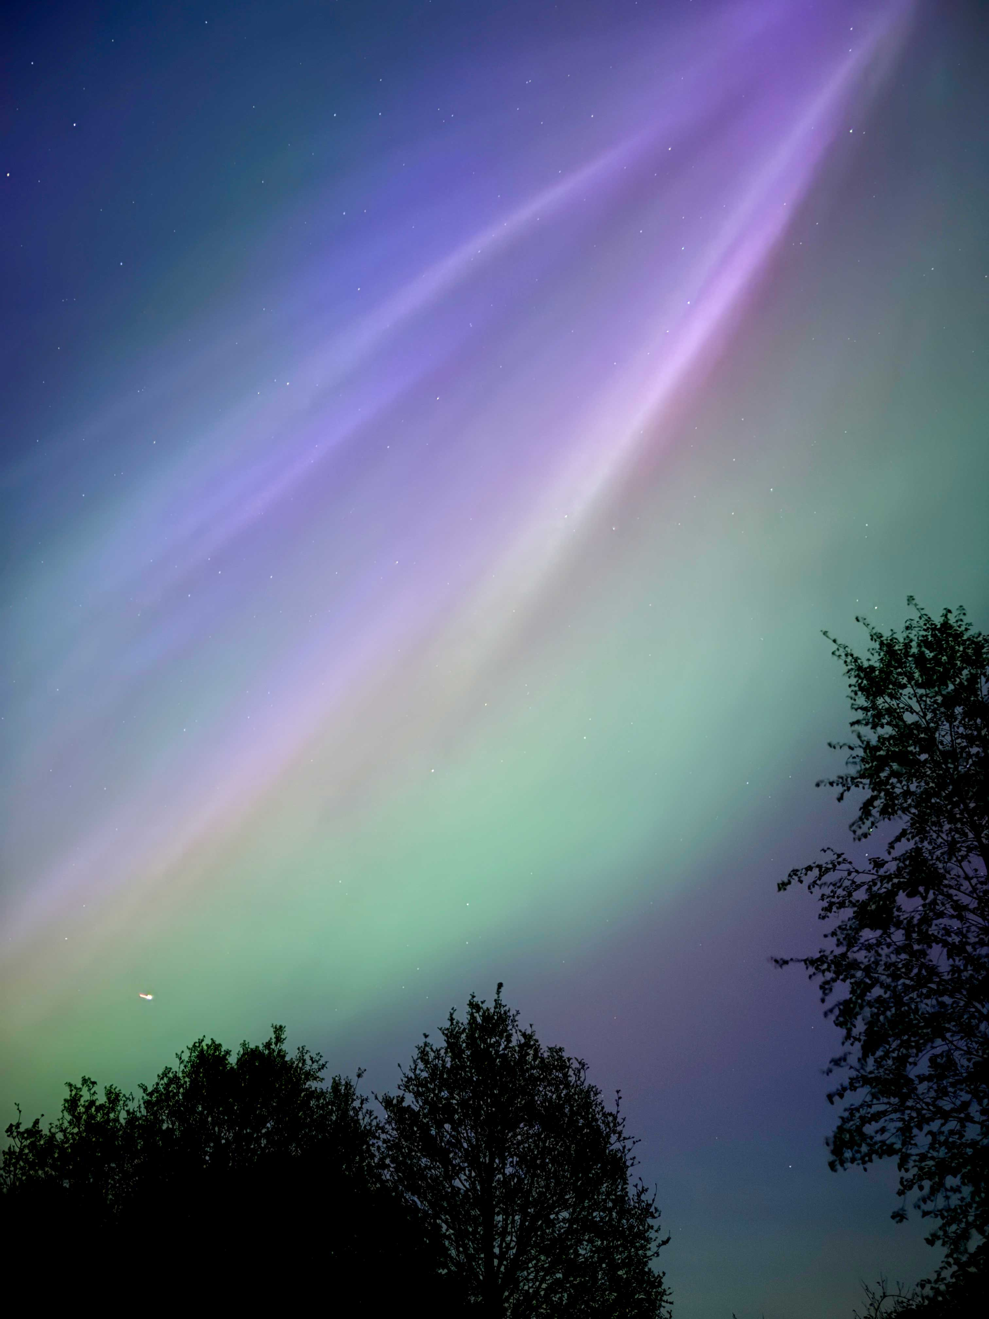
W3Winner
Richard Jackson - Aurora 3

Slide 4
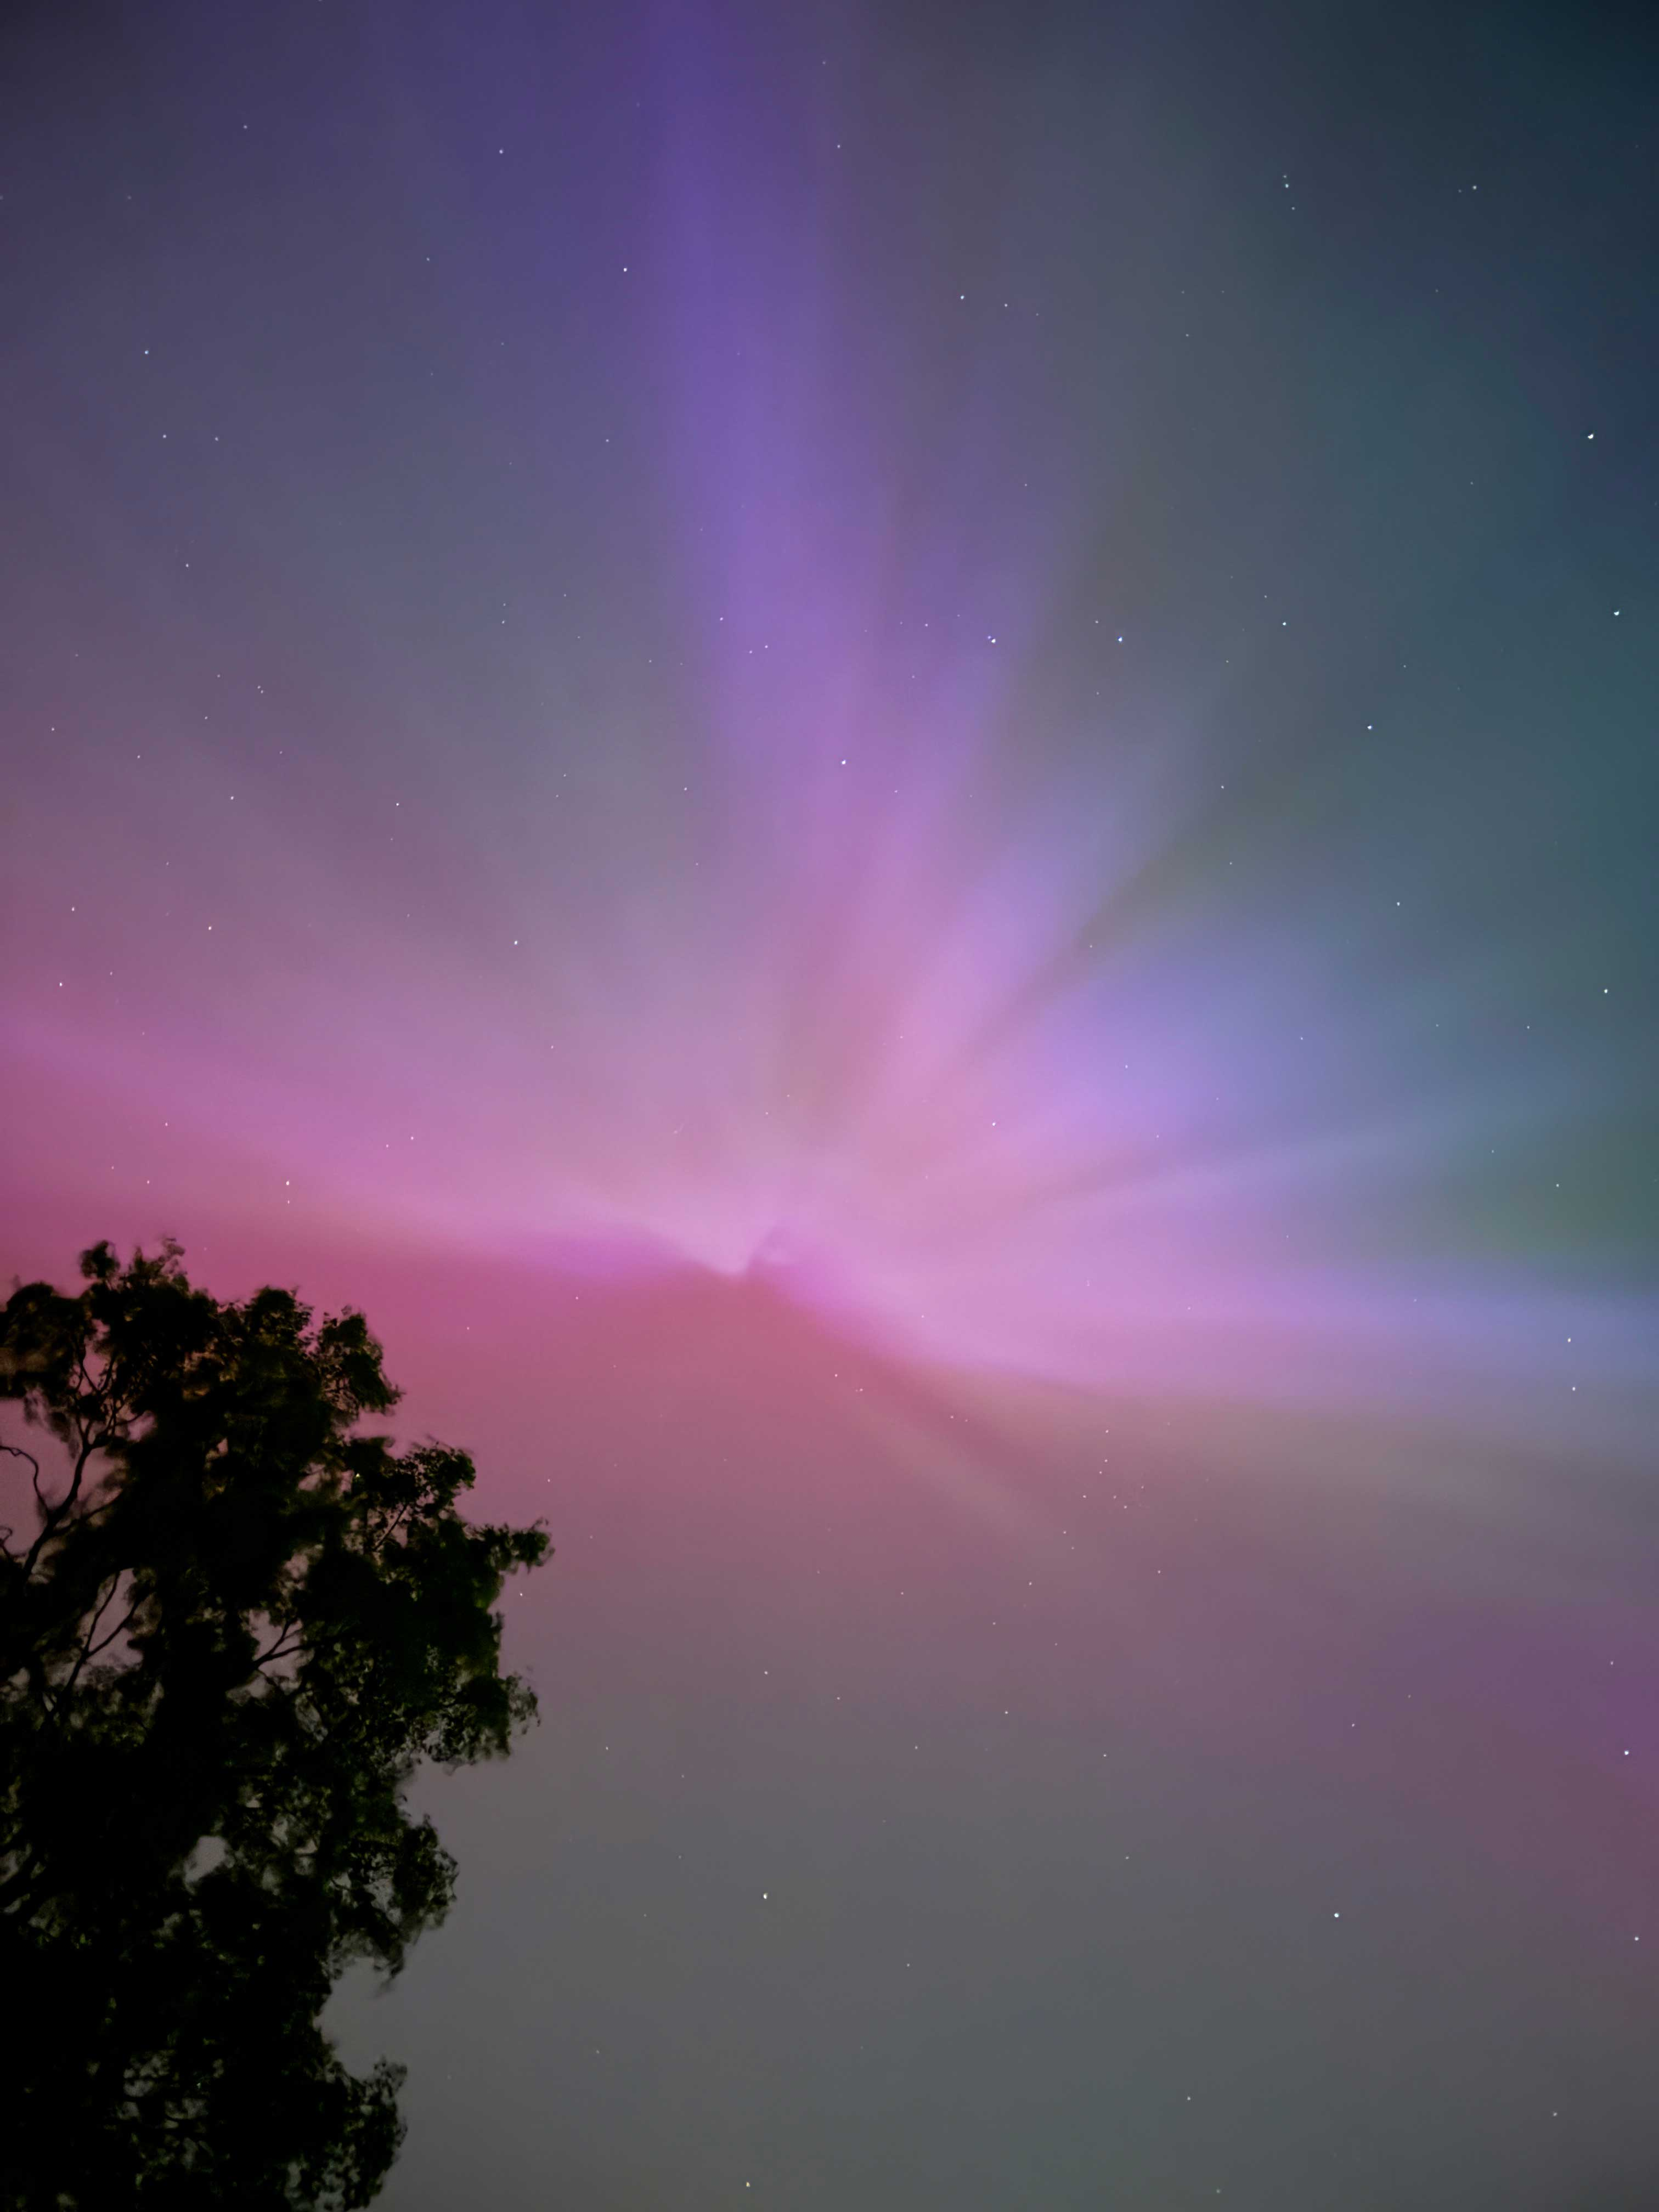
W1
Richard Jackson - aurora and Plough

Slide 5
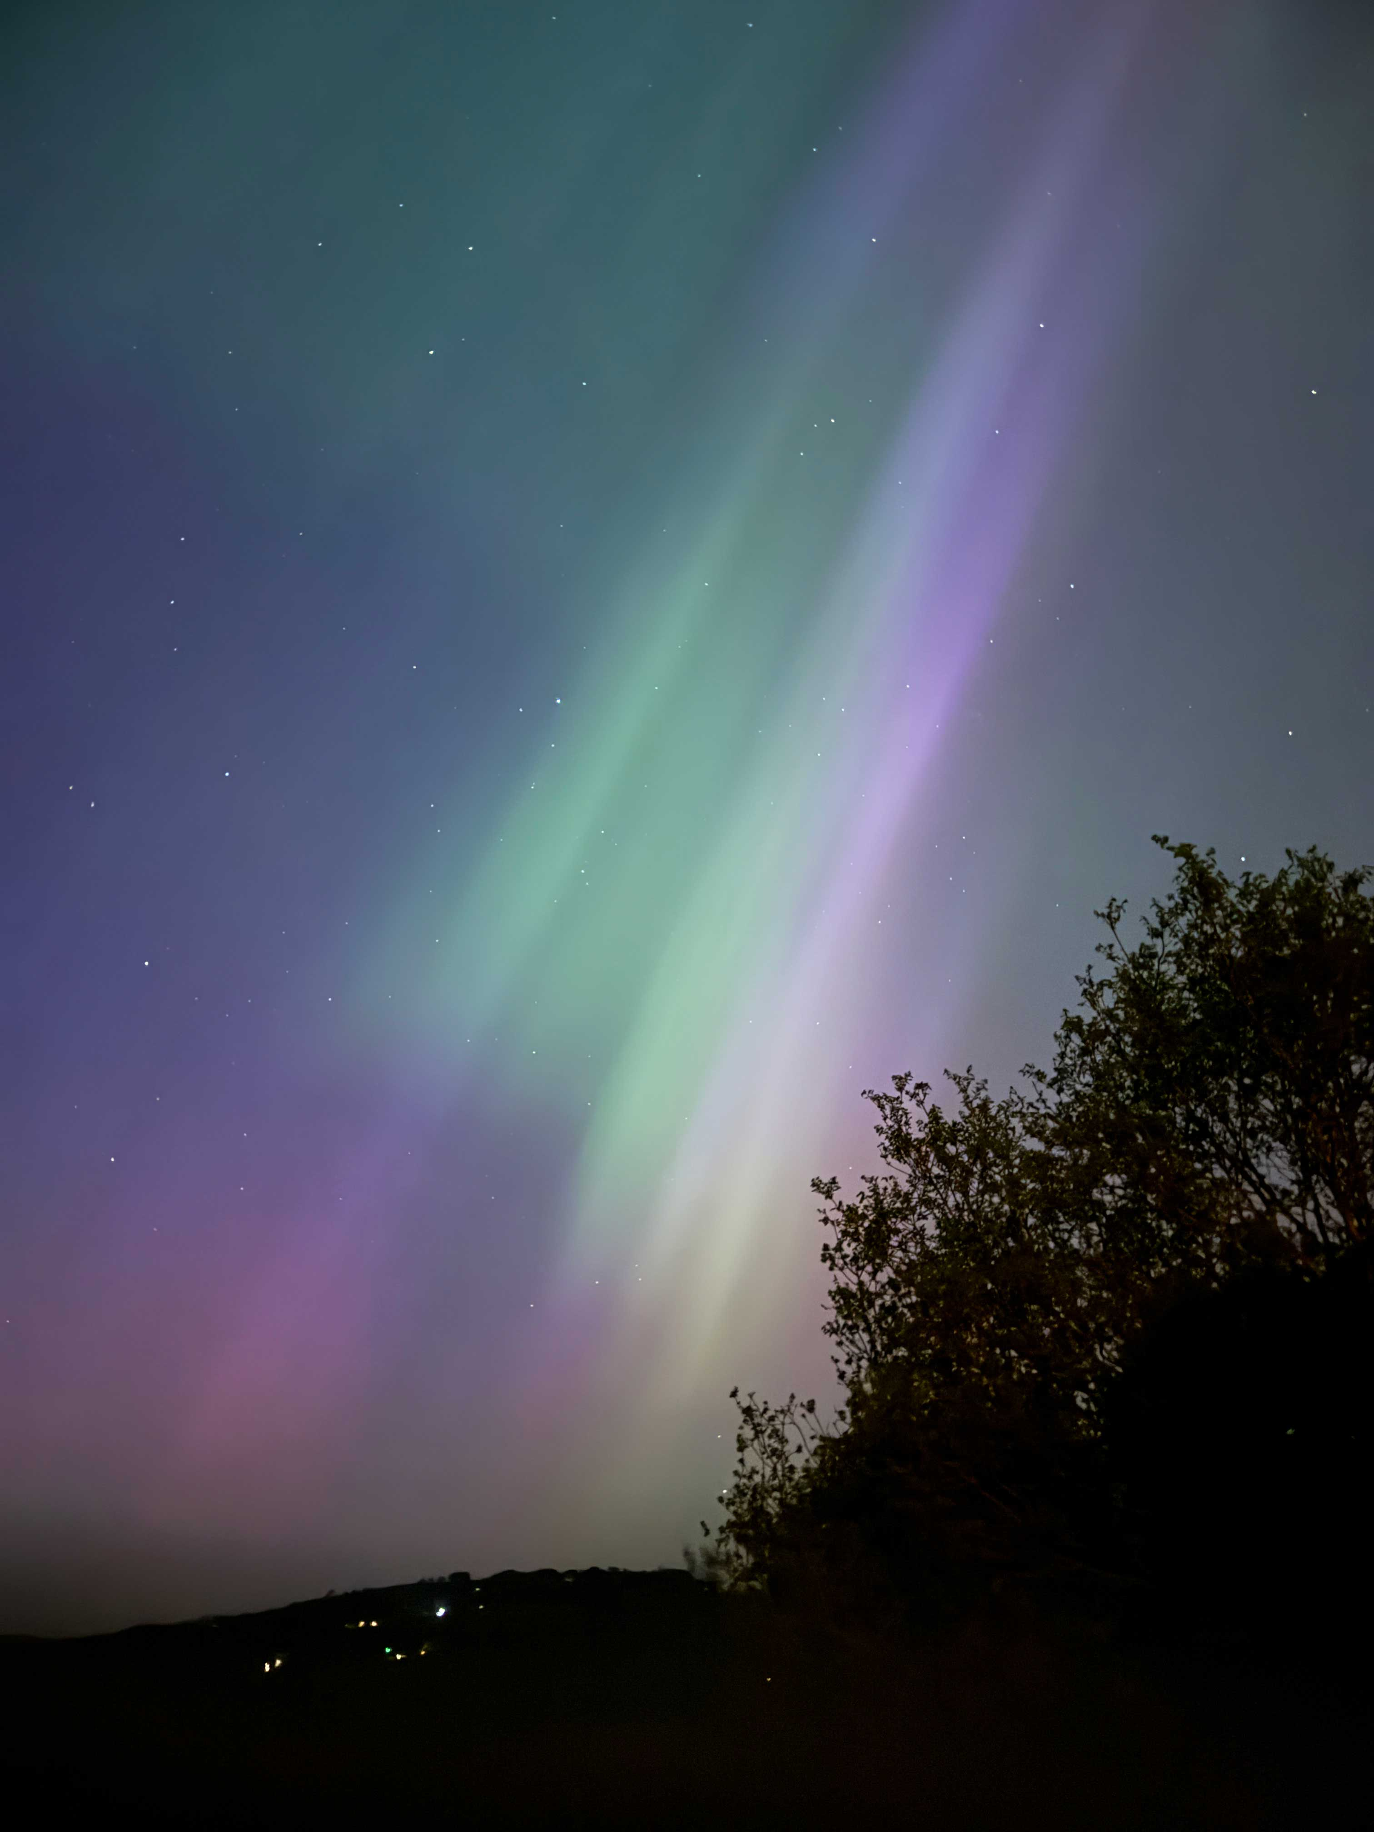
W2
Richard Jackson - Aurora 2

Slide 6
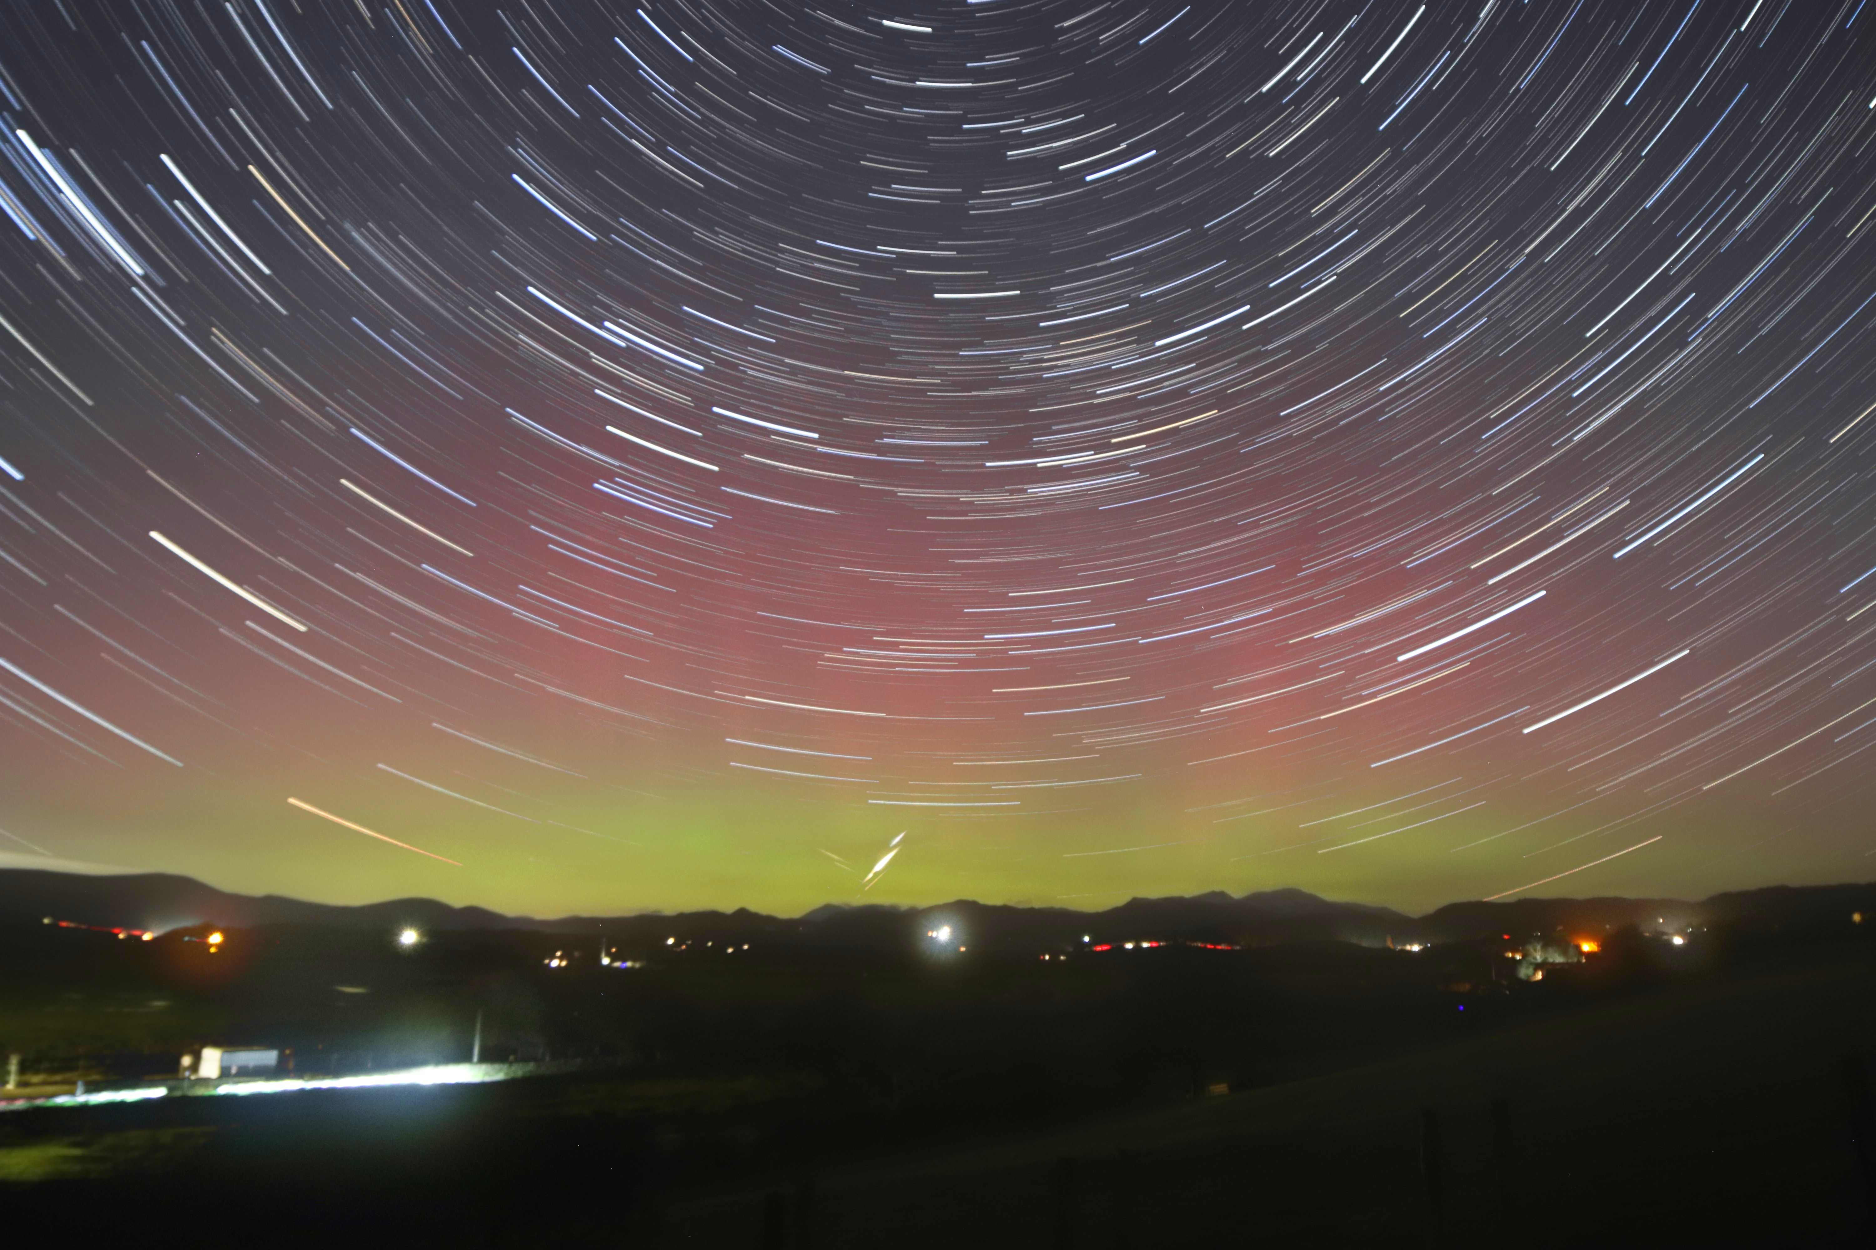
W4
Brian Corfield - A quite long entry name that might cause it to exceed tyhe space allowed

