Slide 1

MaccAstro Imaging Trophies
2024 Competitions – XX Submissions (anonymous)

Slide 2
Willcox Wide-sky Trophy Section
7 Entries

Slide 3
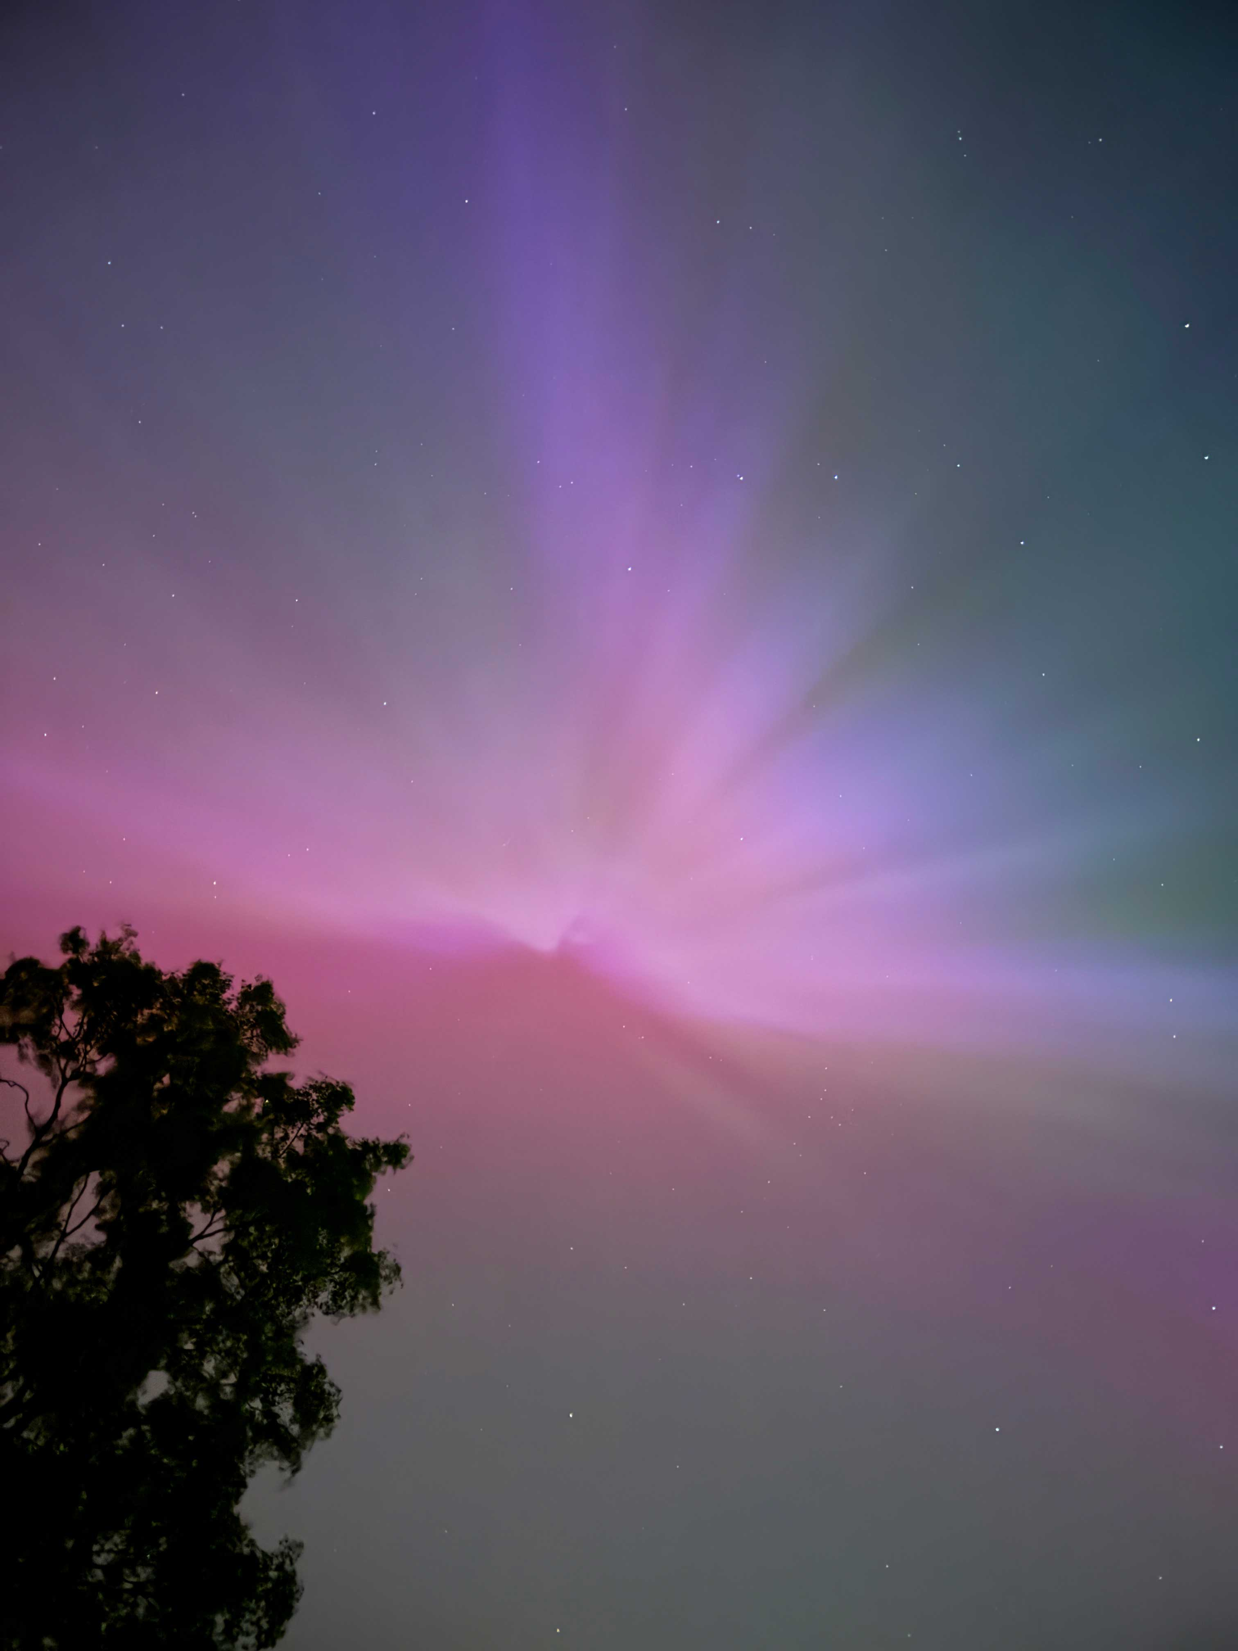

Slide 4
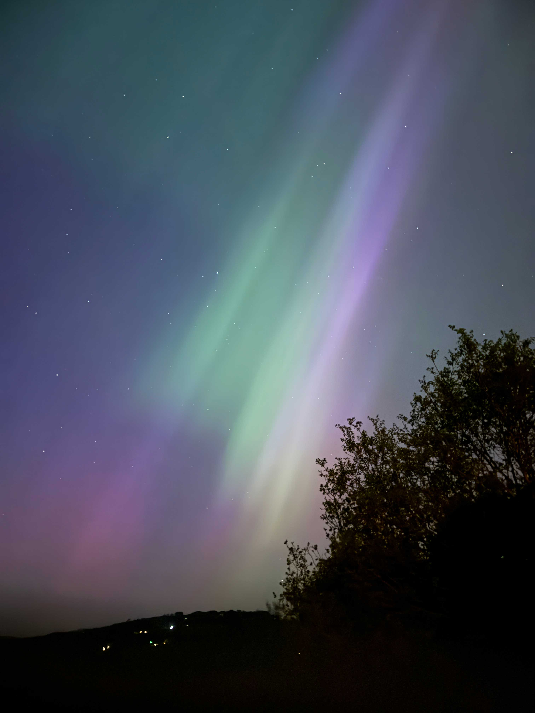

Slide 5
